Slide 1
Unlabeled Data Improves Adversarial Robustness
Yair Carmon, Aditi Raghunathan, Ludwig Schmidt Percy Liang, John C. Duchi

Slide 2
Problem
Make more robust classifiers while keeping accuracy:
Previous work theoretically proved the need for more data to achieve robustness than good accuracy for simple models
Previous work looked into gaining robustness by transferring robust models trained with a lot of labelled data
Robustness Requires Data:
Data is expensive and hard to get
Is it possible to create a robust model without needing a lot of labelled data?
Answer: Semi-Supervised Learning with a Twist

Slide 3
Semi-Supervised Learning: Self Learning Framework
Labelled Data
Trains
Model A
All Data
Labelled Data
All Data’
Labels
Unlabelled Data
Forms
Pseudo Labelled Data

Slide 4
Semi-Supervised Learning: Self Learning Framework
All Data’
Trains
Model B

Slide 5
The Twist
Usual Assumption: Low Accuracy on Model A
Paper’s Assumption: High Accuracy on Model A

Slide 6
Why will semi-supervised learning work?
Robustness asks classifiers to be stable around naturally occuring inputs
This does not require labels
Robustness has a different goal than semi-supervised learning:
Robustness does not have a lack of labelled points concerning standard error
That is why you can assume the twist
Notes:
define naturally occurring inputs

Slide 7



Overall Goals of this paper
- Using a d-dimensional Gaussian model with perturbations of magnitude
- Model is able to achieve standard error with n0 labelled examples
- Model is able to achieve nontrivial robust accuracy with samples
Notes:
This implies a sample complexity gap in the high dimensional regime d >> n0*episoln^−4. What does this mean?

Slide 8
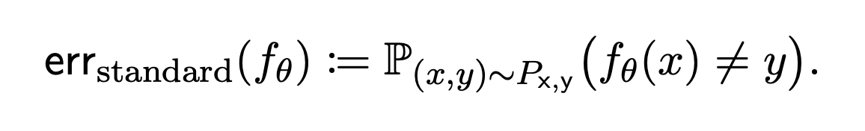

Some Definitions:
Where perturbations =
And p=2 and p=Inf.
Notes:
Explain what the standard error and the robust error are doing

Slide 9

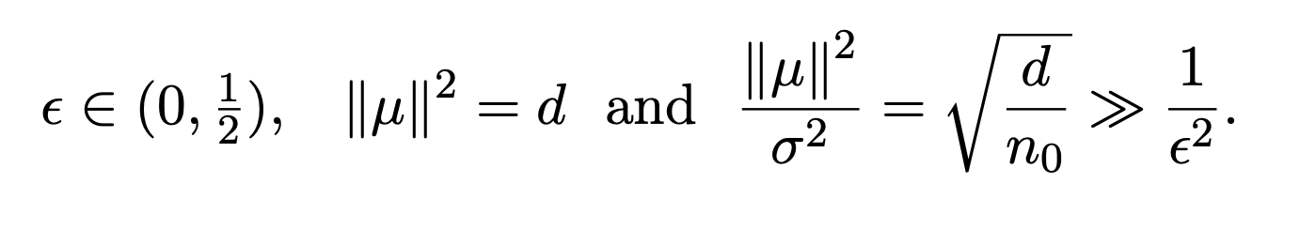
Proving The Goal Theoretically
Goal: i) samples give us accurate classifier, ii) #> give us robust classifier
Model Parameter Setting:

Slide 10
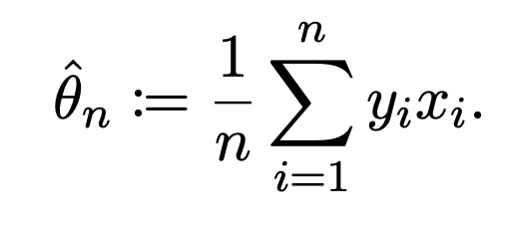
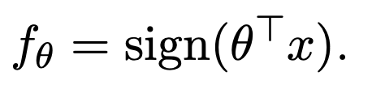
Previous work: supervised setting
Linear Classifier: Perceptron:
Assume examples needed to achieve standard accuracy (proof in appendix 4.2)

Slide 11
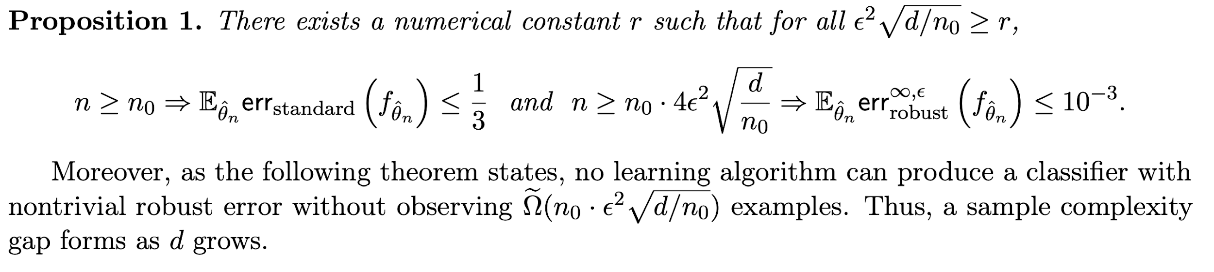
Previous work: supervised setting

Slide 12
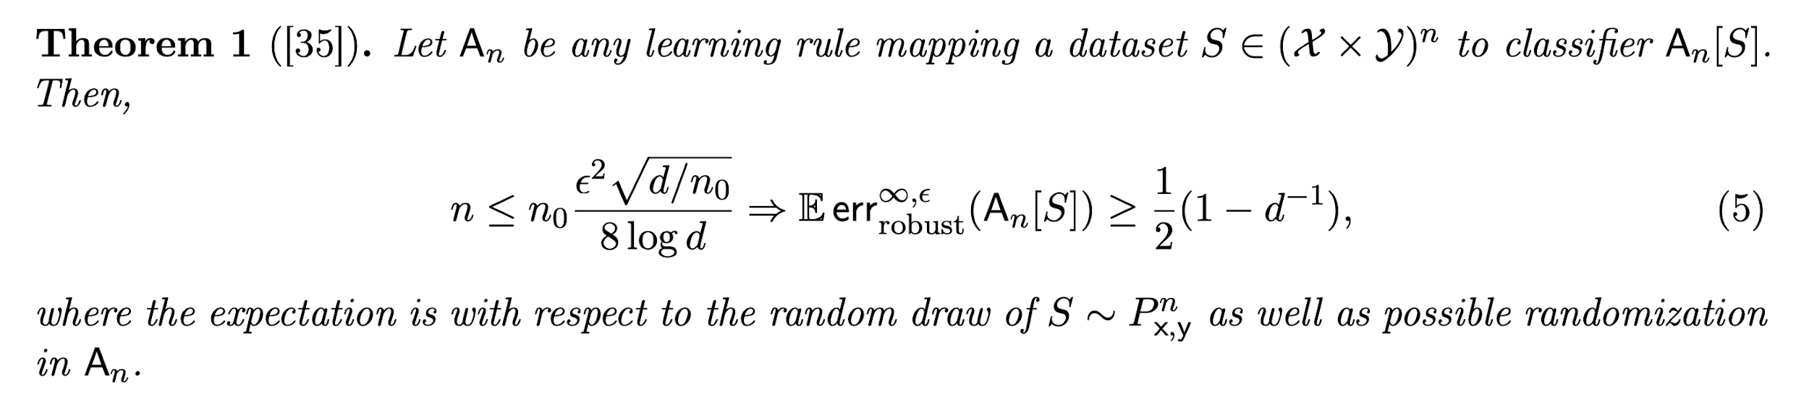
Previous work: supervised setting

Slide 13
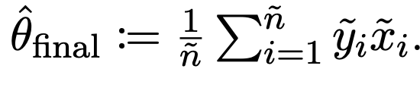
Shifting to semi-supervised setting
Assume n labelled points, ñ unlabelled points then creating pseudo labels for ñ -> ỹ then perceptron gives final classifier as:

Slide 14
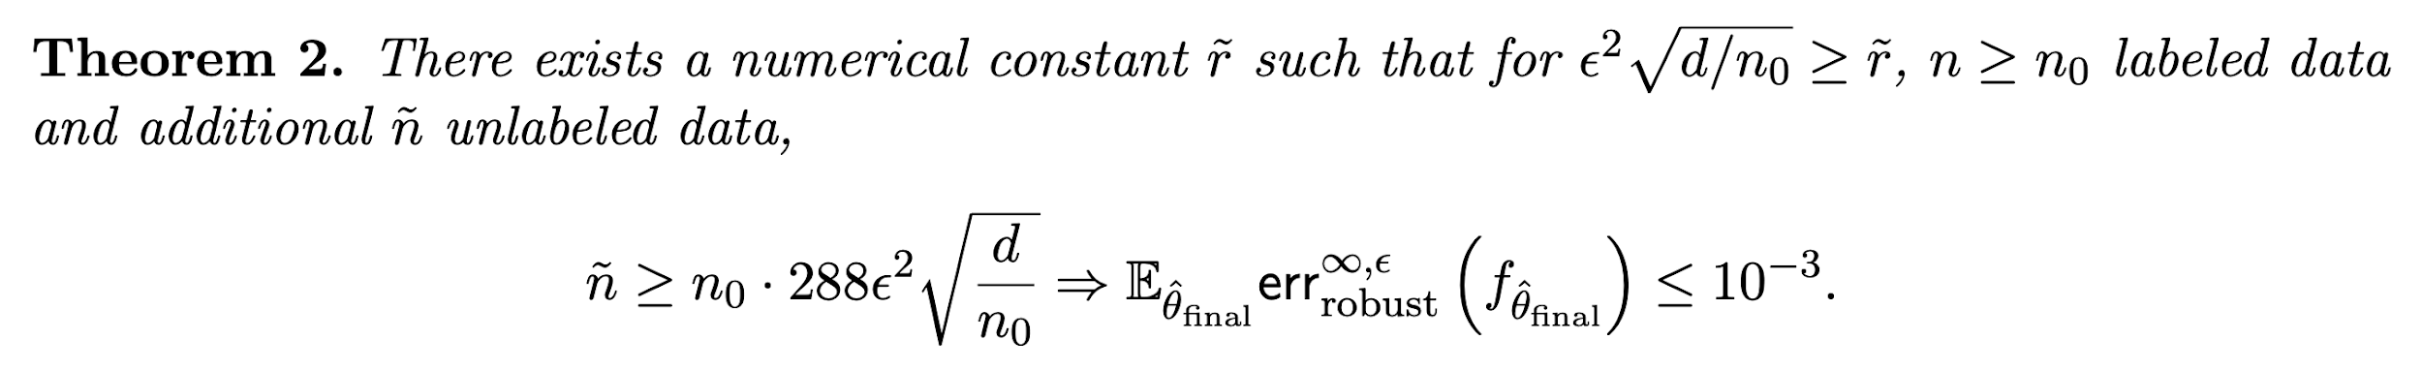
Shifting to semi-supervised setting
is guaranteed high robustness by:
Proof in Appendix
Notes:
This is good because: we only need a constant number of input samples compared to the supervised setting, and epsilon^2(sqrt(d/n0)) fewer labels

Slide 15



What about irrelevant unlabeled data
Given a fixed where of the data is relevant, the number of required relevant examples grows by a factor of

Slide 16
Algorithm
Take a self-supervised approach except loss function changes for final classifier:
Note that unlabelled points have a w value so they can be down weighted since labelled points are more relevant to task and have better labels

Slide 17
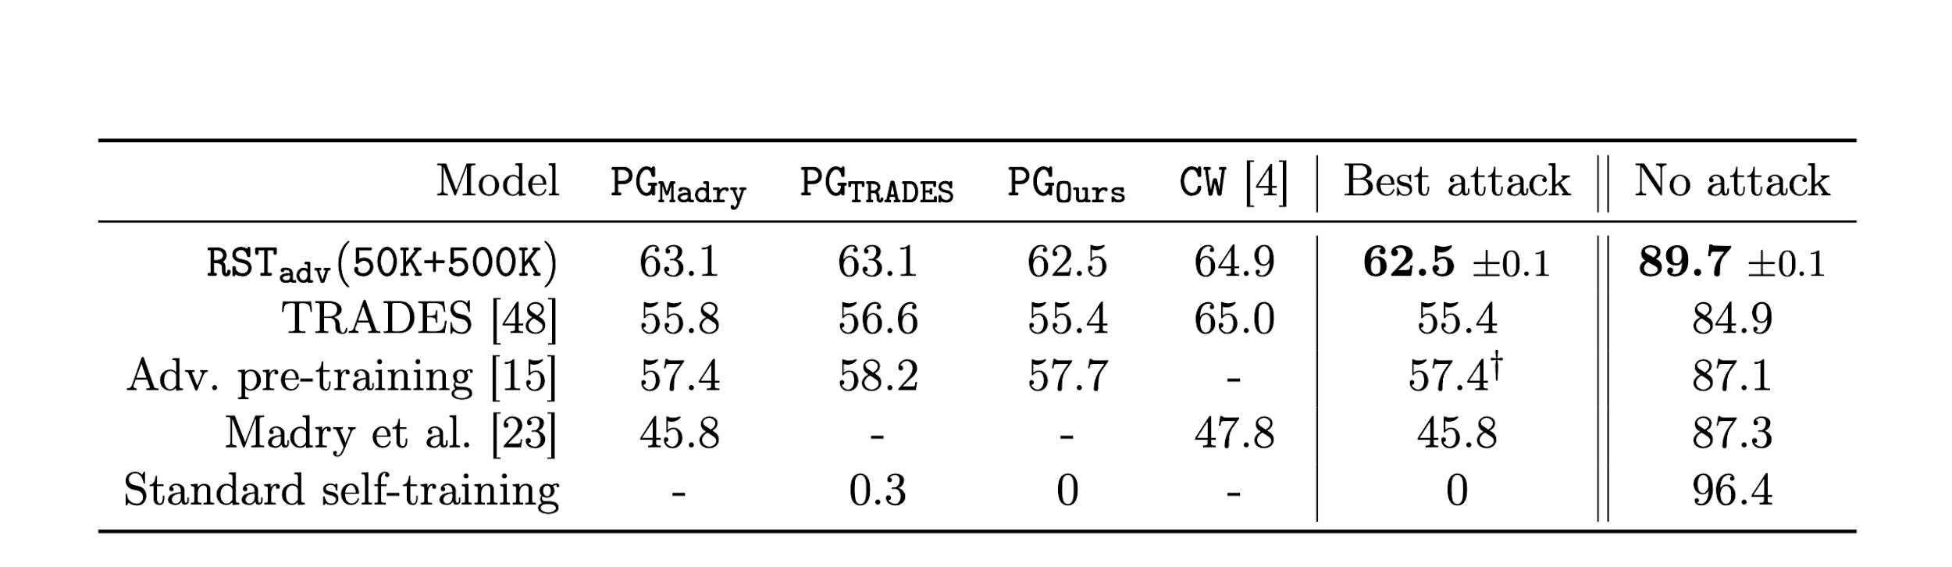
CIFAR-10 test L(inf) bound
50K supervised data, and 500K unsupervised data

Slide 18
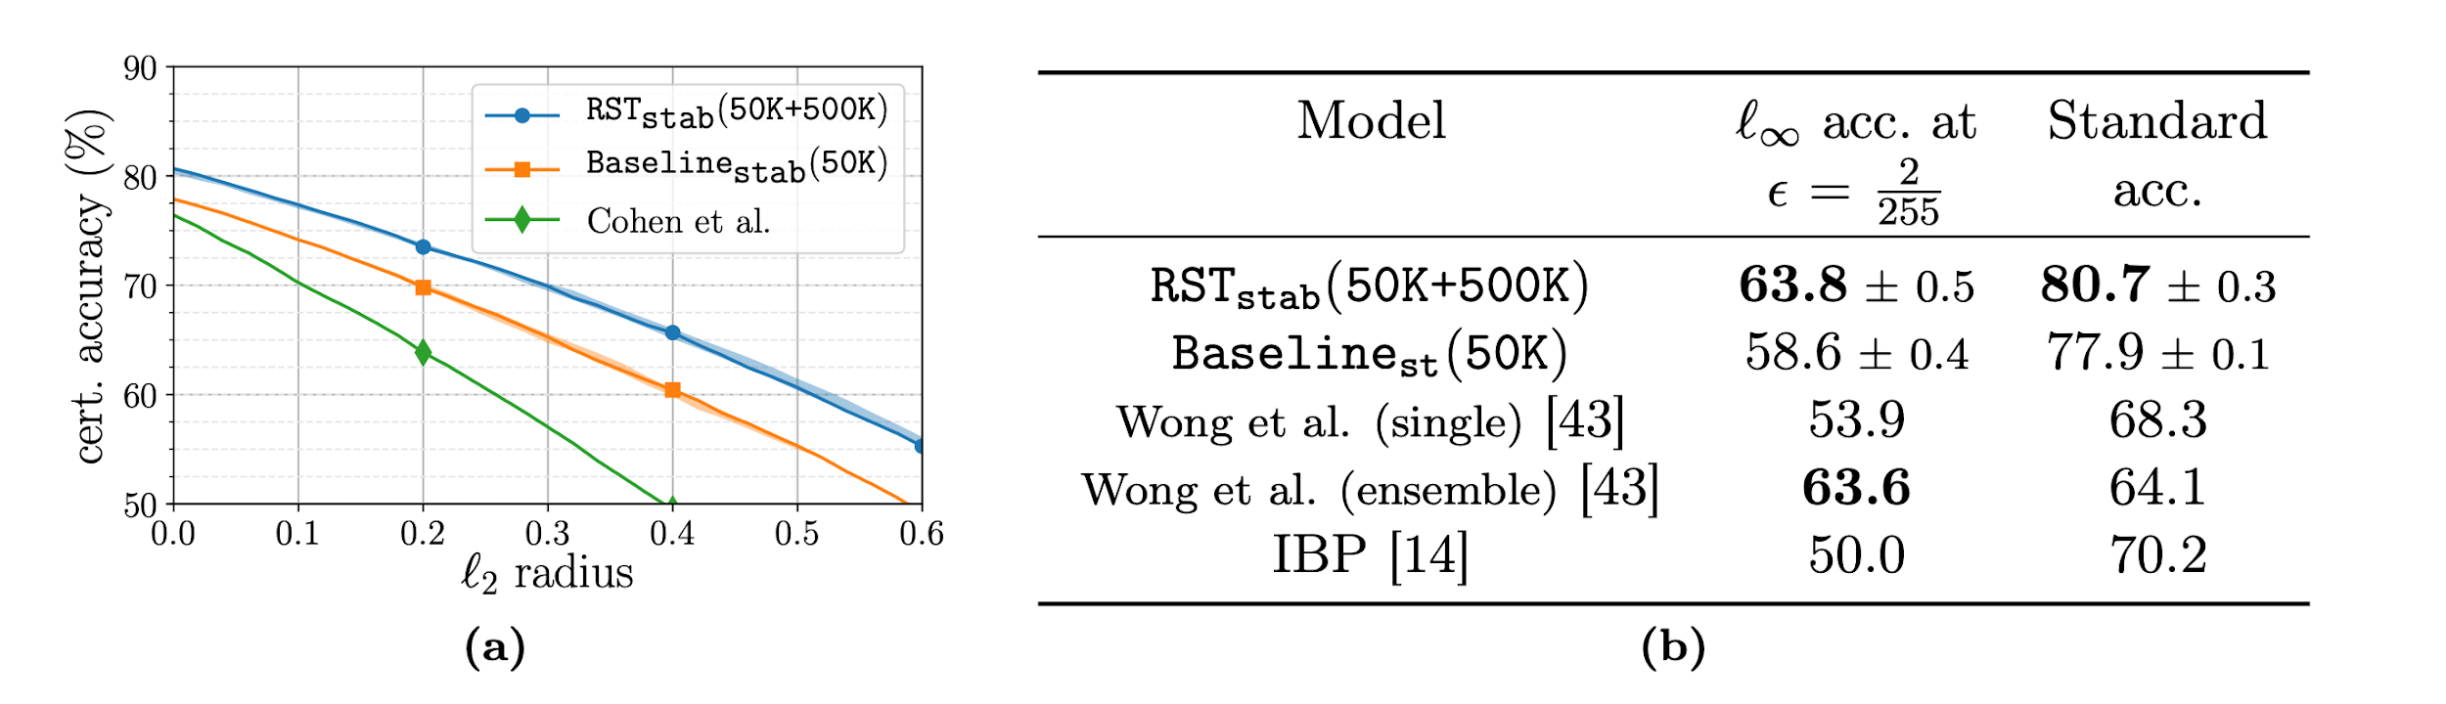
CIFAR-10 test L2 bound
50K supervised data, and 500K unsupervised data

